Slide 1
CF26 Brand Toolkit
For questions - contact Serena Flaxenburg (sgflax@umich.edu)

Slide 2
Content
Logo
SWE/TBP Logo Rules
Color palette
Fonts
Slides
Documents
Email signature

Slide 3







Logo (1/2)
Logo files can be found here.
Original logo (with CF26 title)
Should be used when there is no explicit context of CF26
Original logo (without CF25 title)
Should be used when there is an explicit context of CF25 (e.g., ‘Fall Eng Career Fair’ is already in the titles)
Simplified logo (favicon)
Is not a logo and use should be avoided, except in big banners

Slide 4
Logo (2/2)
Use of logo is not a must.
Do not distort the logo, add borders or re-arrange the texts.
Size: make sure the slogan on the logo is readable upon printing/web display.
Position: preferably on the center bottom or the right bottom (see right).
Background: do not use multiple colors
Example CF26 Flyer
LOGO SPOT 1
LOGO SPOT 2

Slide 5


SWE/TBP Logos - Links (1/3)
Attached here is a folder with commonly used SWE and TBP logos for promotional use.
SWE’s member resources page also has a wealth of different colors, guidelines, and AI files with their logo.

Slide 6
SWE/TBP Logos - Logo Use (2/3)
When utilizing the SWE and TBP logos, please only use high quality PNGs! Do not screenshot a logo and use it because those images are not scalable.
Additionally, please do not make additions or alterations to these logos as SWE and TBP have their own branding guidelines and IPs

Slide 7


SWE/TBP Logos - Order (3/3)
When creating promotional materials with both the SWE and TBP logos, please put the SWE logo on the left and/or top and TBP logo on the bottom/right. In the interest of keeping all things equal, we sort the logos alphabetically, so SWE goes first.

Slide 8
Color Palette (1/4)
black and white
#ffcb0aff #454a65ff #8c8a51ff #462e18
Other colors may be used in a limited amount.

Slide 9

Color Palette (2/4)
Do’s: high-contrast
Don’ts: low contrast, mixing dark colors, similar colors

Slide 10



Color Palette (3/4)
CF26
Suggested color groups
CF26
CF26
CF26
CF26
CF26
CF26
Get ready for CF25!

Slide 11
Fonts (1/2)
Gill Sans
Titles and short texts, for presentations and documents
Gill Sans Semi Bold - titles
Gill Sans Regular - short texts
Lora
Long texts, for documents
Lora Normal/Bold - long texts

Slide 12
Fonts (2/2)
Other appropriate fonts may be used for design purposes (e.g., poster title, highlight texts) only.
Do’s: sans-serif fonts easily readable for digital screens and large texts, any artistic and readable fonts
Don’ts: too cartoonish, causal, difficult-to-read, similar/interchangeable with official fonts
Career Fair
Career Fair
Career Fair
Career Fair (interchangeable)
Career Fair
Notes:
https://mariahalthoff.com/blog/typography-dos-and-donts

Slide 13
Slides
Font size
Main texts should be 18 pt or larger. Slide titles should be 24 pt or larger.
Font type
Gill Sans Regular
Bullet point style
None, indentation only or ‘-’

Slide 14
Documents
Document example can be found here.
Line spacing
1.15 - 1.5 spacing between lines
Font size
between 12 and 14 pt

Slide 15


Promotional Materials (1/2) - Flyers
Dos:
  Include the “Hosted By” section in top-right corner with TBP/SWE logos
  Include the CF26 logo and website URL in the bottom-right corner
Samples (left) provided as an example – not needed to follow stringently

Slide 16
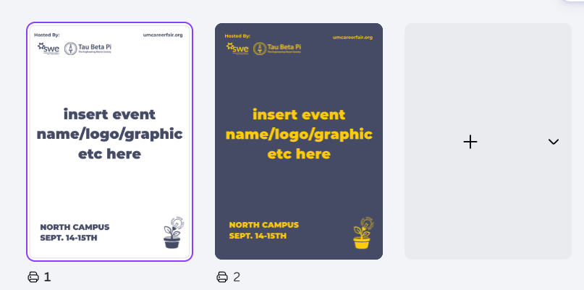
Promotional Materials (2/2) - Flyers
Click here for a canva template to copy and add your info for flyers

